Slide 1
SB 1: MAXIMIZING ACCESSIBILITY AND COMMUNITY BENEFITS
Webinar| July 10, 2017

Slide 2
Agenda
Overview of Senate Bill 1
Principles for Investment
Program by Program
State Guidelines Development Process
How to Get Involved
Q&A

Slide 3
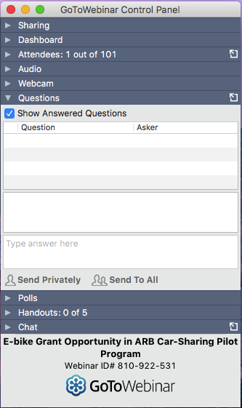
Using GoToWebinar
Ask questions at any time in the ‘Questions’ box
Technical Difficulties?
linda@calbike.org

Slide 4
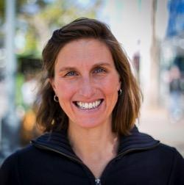
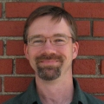
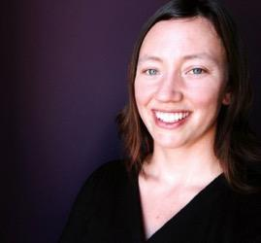
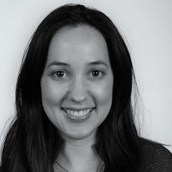
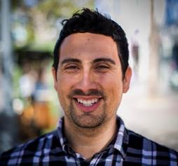
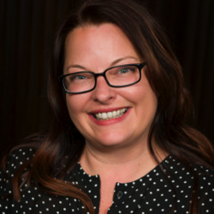
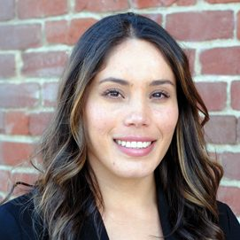
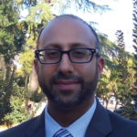
Speakers
Jeanie Ward-Waller
Policy Director
California Bicycle Coalition
Josh Stark
State Policy Director
TransForm
Carey Knecht
Director
ClimatePlan
Erika Rincón Whitcomb
Senior Associate
PolicyLink
Jared Sanchez
Policy Associate
California Bicycle Coalition
Michelle Pariset
Policy Advocate
Public Advocates
Veronica Garibay
Co-Director
Leadership Counsel for Justice & Accountability
Shrayas Jatkar
Policy Advocate
Coalition for Clean Air

Slide 5
Overview of Senate Bill 1

Slide 6
SB 1: Road Repair & Accountability Act of 2017
April 28
Signed into law
November 1
Gas tax increase goes into effect
LANDMARK INVESTMENT
First state gas tax hike since 1994
Focused on “fix-it-first” rather than road expansion
Largest proportion of multi-modal investments
Includes language to “address highest transportation needs…”
Notes:
SB1 continues funding for infrastructure projects along high-volume trade corridors in California.

Slide 7
SB 1: Road Repair & Accountability Act of 2017
HOWEVER…
Vast majority of funds for roads
Highway expansion still eligible through several programs
Only Active Transportation and Rail Programs have an equity priority
Controversial gas tax increase comes with urgency to show results quickly (repeal measure released July 10)
Critical to serve transportation needs across the state effectively
Notes:
SB1 continues funding for infrastructure projects along high-volume trade corridors in California.

Slide 8
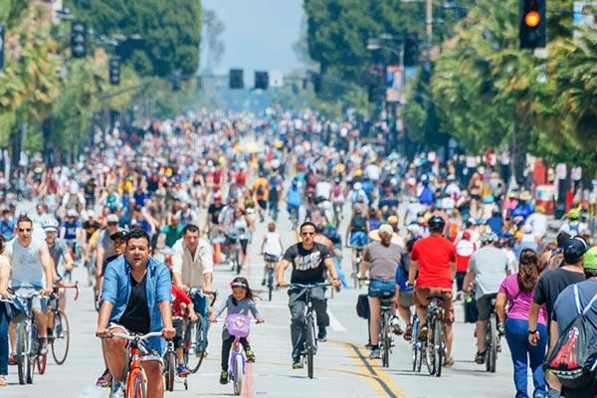
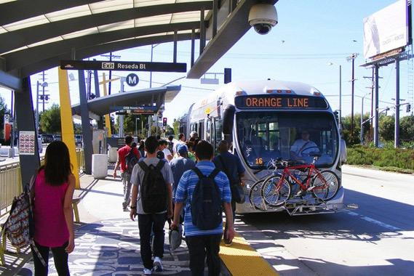
Statewide Survey Stats
Strong support for Complete Streets
8 in 10 Californians think that transportation departments should change the way they build streets and roads to make them safe for all users
Support for Alternatives to Driving
Nearly half of voters support investment in alternatives to driving--public transportation, walking, and bicycling--as an equal or higher priority to improving freeways and roads
Notes:
(Jeanie)

Slide 9
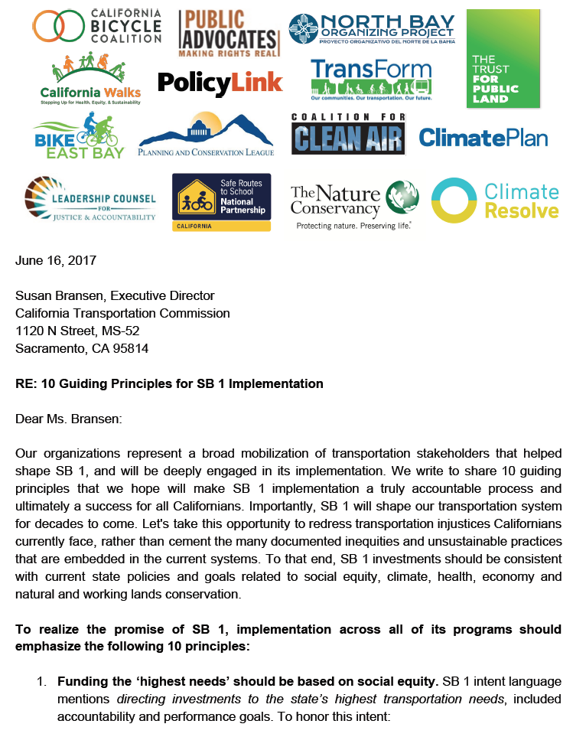
10 Principles for Investment
1. Fund the ‘highest transportation needs’ based on social equity
2. Undertake inclusive outreach and engagement
3. Reduce air pollution & climate change impacts, especially for most vulnerable
4. Promote healthy communities and health outcomes
5. Expand access to workforce training and jobs
Notes:
SB1 continues funding for infrastructure projects along high-volume trade corridors in California.

Slide 10
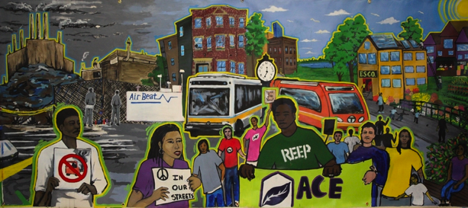
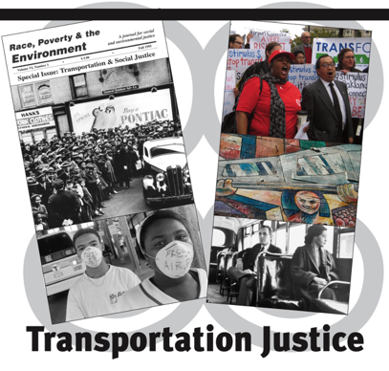
10 Principles for Investment
6. Tie strong performance measures to state goals
7. Support mode shift to cleaner transportation options
8. Require complete streets for all road projects
9. Avoid impacts to natural lands and enhance regional sustainability
10. Advance housing affordability and mitigate displacement
Notes:
SB1 continues funding for infrastructure projects along high-volume trade corridors in California.

Slide 11
SB 1 Funding by Program
$5.4B total, annual

Slide 12
SB 1 Funding by Program
Capital & Support Programs
Repair & Maintenance Programs

Slide 13
Program by Program

Slide 14
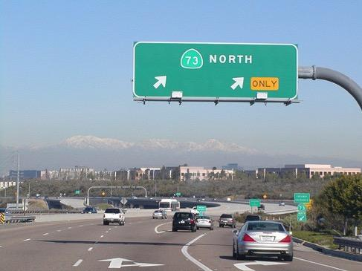
State Highway Operation & Protection Program $1.9B per year to Caltrans
PROGRAM OBJECTIVES
Repair pavement, bridges, drainage on state highways* to good conditions
Performance targets established in SB 1
Where feasible include:
Complete streets elements
Advanced materials
Systems for electric & autonomous vehicles
Climate adaptation
*State highways are freeways, rural roads, as well as main streets and arterials in urban, suburban, rural communities

Slide 15
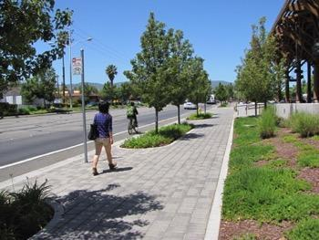
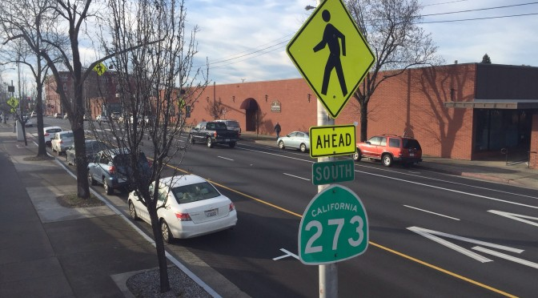
State Highway Operation & Protection Program
RECOMMENDATIONS
Caltrans should consult with local residents and stakeholders on project development to meet local needs
Improve walk, bike, and bus facilities during road repair to build safe, complete streets
Prioritize safety of vulnerable users by reducing speeds and calming traffic in neighborhoods and developed areas
Include green infrastructure to mitigate climate and environmental impacts and improve streetscape

Slide 16
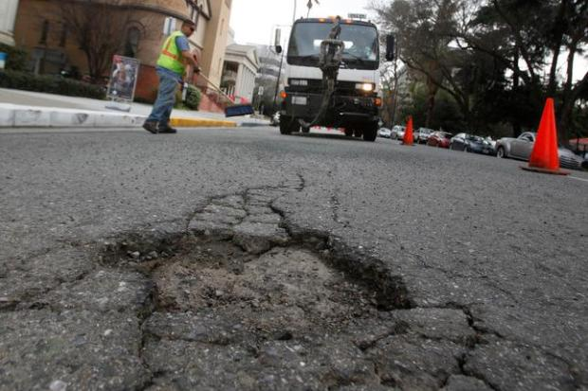
Local Streets & Roads Maintenance $1.5B per year to Cities and Counties by formula
PROGRAM OBJECTIVES
Repair pavement, bridges, drainage on local streets to good conditions
Performance targets established in SB 1
Once pavement condition target reached, funds can be used for transportation capital projects
Where feasible include:
Complete streets elements
Advanced materials
Systems for electric & autonomous vehicles
Climate adaptation

Slide 17
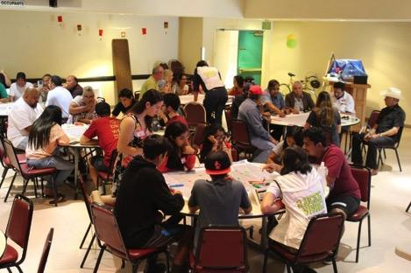
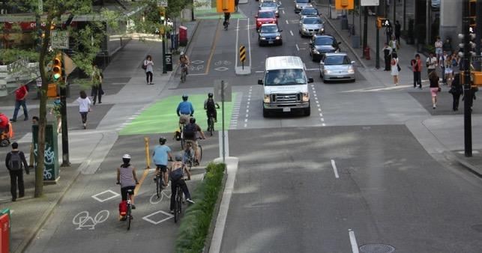
Local Streets & Roads Maintenance
RECOMMENDATIONS
Urge cities and counties to prioritize low-income and underserved neighborhoods
Agencies should consult with local residents and stakeholders on project development
Improve walk, bike, and bus facilities during road repair
Prioritize safety of vulnerable users by reducing speeds and calming traffic
Include green infrastructure

Slide 18
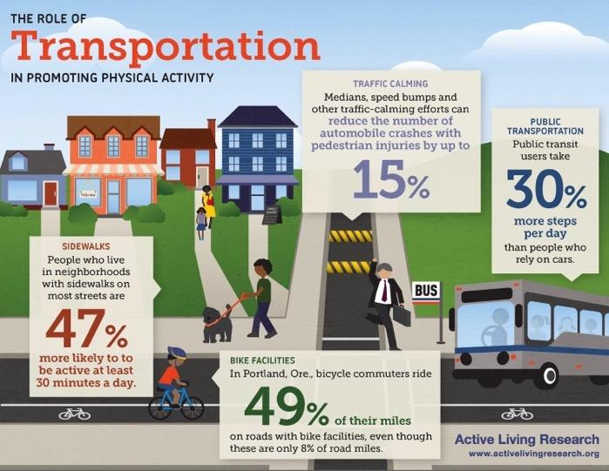
Active Transportation Program $100M more per year to CA Transportation Commission for competitive grants
PROGRAM OBJECTIVES
Increasing walking and biking, improving safety and public health, reduce greenhouse gases
Benefit disadvantaged communities (25% minimum)
Award new funds now to more Cycle 3 projects
Make more transformational investments in Cycle 4

Slide 19
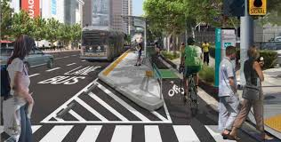
Active Transportation Program
ATP Augmentation - $200M
Opportunity for Cycle 3 applicants to get an award and expedite project schedule
Call for Projects June 30
Re-application deadline Aug 1
ATP Cycle 4 - $440M
Next full grant cycle for four years of funding starting 2019
Changes to simplify application for different project types
Workshops Fall 2017
Call for Projects Spring 2018

Slide 20
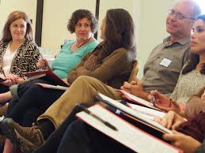
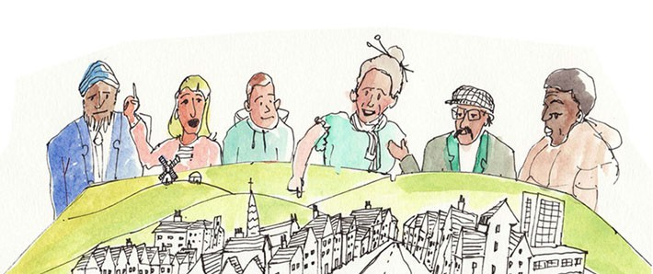
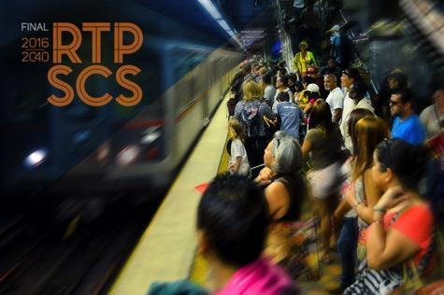
Local Planning Grant Program $25M per year to Caltrans for competitive grants
PROGRAM OBJECTIVES
Expand Sustainable Communities Planning Grant Program
Assist regional agencies in updating their sustainable communities strategies

Slide 21
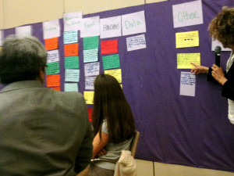
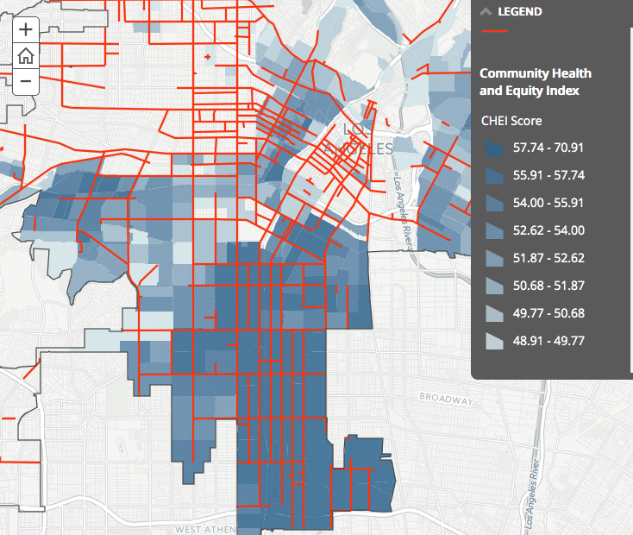
Local Planning Grant Program
RECOMMENDATIONS
50% set aside for disadvantaged communities
Transparent scoring aligned to climate, health, equity, environment goals
Competitive selection process
Strong eligibility thresholds

Slide 22
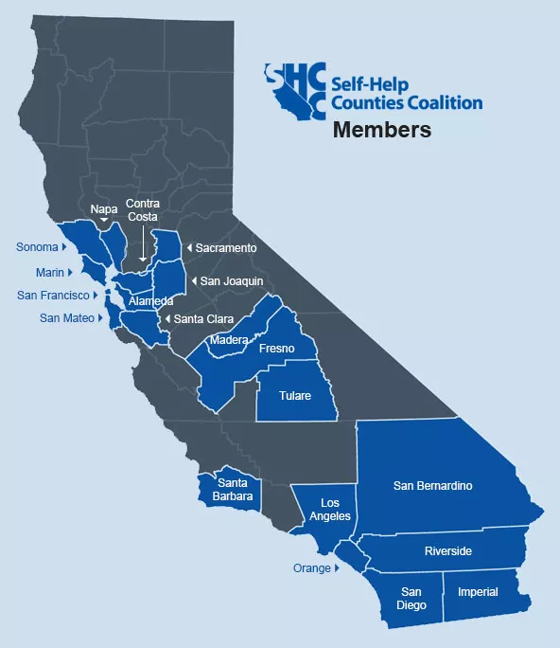
Local Partnership Program $200 million per year
50% to CTC for competitive grants
50% to ‘self-help’ local agencies by formula
PROGRAM OBJECTIVES
Road maintenance, rehabilitation, and other transportation improvement projects through state and local partnership
Leverage local measure funds
Incentivize adoption of local sales tax measures for transportation

Slide 23
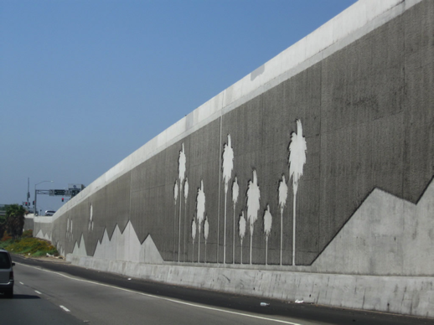
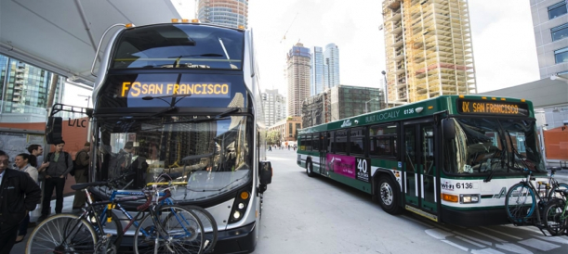
Local Partnership Program
RECOMMENDATIONS
Align performance criteria with equity, health, and climate goals
Limit highway expansion and invest in parallel transit, bike, walk improvements
Provide direct benefits to the residents of the community
Use road rehab to create complete streets

Slide 24
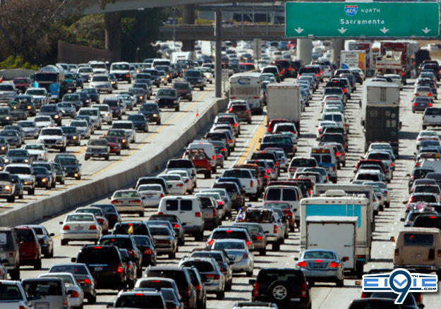
Solutions for Congested Corridors Program $250 million per year to CA Transportation Commission for competitive grants
PROGRAM OBJECTIVES
Support more transportation choices in highly-traveled corridors
Projects must be in a comprehensive corridor plan and a RTP-SCS
Scoring criteria include: safety, congestion, accessibility, economic development & job creation, air quality and GHGs, efficient land use, deliverability, matching funds

Slide 25
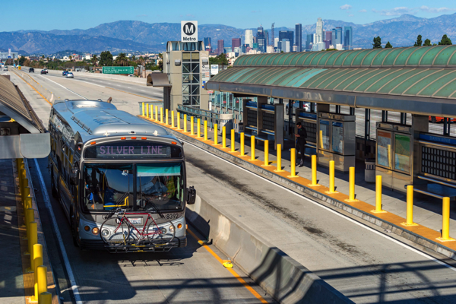
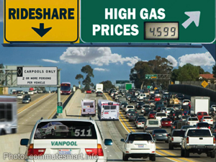
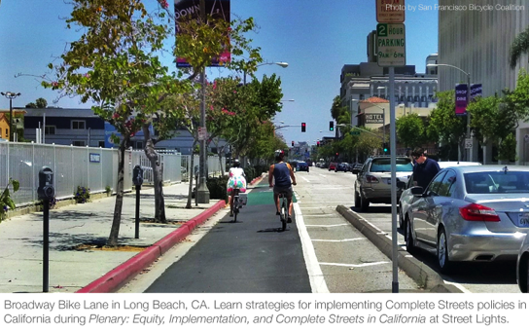
Solutions for Congested Corridors Program
RECOMMENDATIONS
Focus on improving congestion by person-throughput rather than vehicles and reducing vehicle-miles traveled
Limit highway expansion and invest in parallel transit, bike, walk improvements
Provide direct benefits & access to opportunity to the residents of the community
Avoid displacement & foster stronger planning for affordable housing
Require robust public engagement in planning and development of projects

Slide 26
Transit & Intercity Rail Capital Program $245M per year to State Transportation Agency (CalSTA) for competitive grants
PROGRAM OBJECTIVES
Expand transit and rail service through capital projects
Reduce greenhouse gases
Improve interconnection to high-speed rail
Invest 25% to benefit disadvantaged communities
Notes:
(Josh)

Slide 27
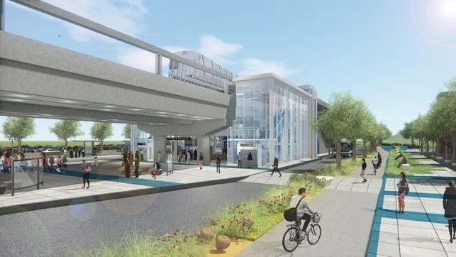
Transit & Intercity Rail Capital Program
RECOMMENDATIONS
Push transit agencies to apply for projects that benefit communities and reduce vehicle-miles traveled
Examples:
Zero-emission buses
accessible rail cars
station area improvements for bike/walk to transit
integrated ticketing to improve transfers

Slide 28
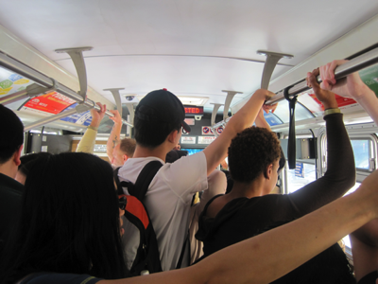
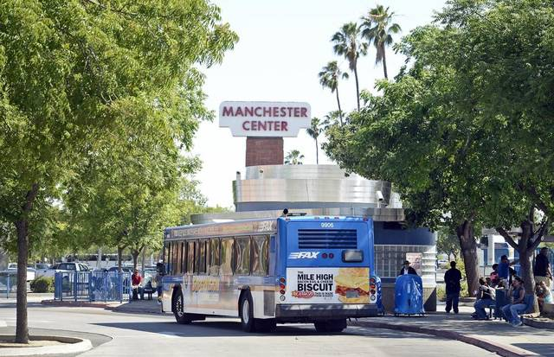
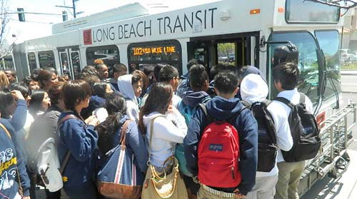
State Transit Assistance $390 million per year to local and regional transportation agencies by formula
PROGRAM OBJECTIVE
Improve and preserve existing transit service

Slide 29
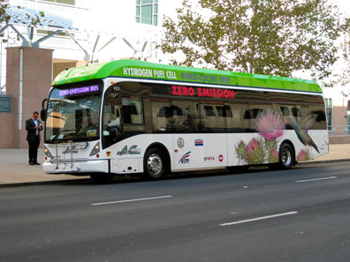
State Transit Assistance
RECOMMENDATIONS
Push transit agencies at the local level to focus funding on improving operations, not capital projects
Restore service cuts that happened during the Recession, especially for low-income neighborhoods
Use funds to reduce fares, i.e. BART resolution on SB 1 funds

Slide 30
Trade Corridors Enhancement Program $300M per year to CA Transportation Commission for competitive grants
PROGRAM OBJECTIVES
Move more goods more quickly
Relieve bottlenecks and congestion along high-volume trade corridors
Reduce environmental, air quality, and community impacts

Slide 31
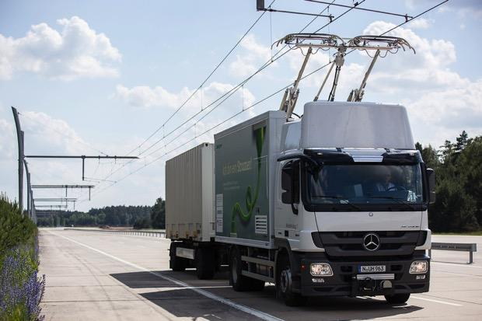
Trade Corridors Enhancement Program
2008-2016
$2 billion
State: Prop 1B
Trade Corridor Improvement Fund
RECOMMENDATIONS
Meaningfully reduce air pollution and other negative impacts from freight
Limit highway capacity-increasing projects
Establish transparent scoring system for project review
Invest in zero-emission technologies and practices
Ensure impacted residents have input on project development
2016-Present
$580 million
Federal: FAST Act
CA Freight Investment Program
2017-
$300 million per year
State: SB1, half of diesel excise tax
California has invested in “trade corridors” since Prop 1B in 2006, which has funded highway expansion but also clean truck and technology incentives
Trade Corridor Enhancement Account
Notes:
SB1 continues funding for infrastructure projects along high-volume trade corridors in California.

Slide 32
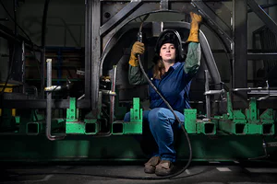
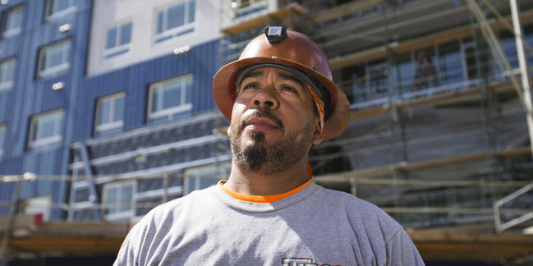
Workforce Development Program $5M per year to Workforce Development Board
PROGRAM OBJECTIVES
Support pre-apprenticeship training programs
Prioritize participation from women, people of color, disadvantaged youth, formerly incarcerated, and underrepresented groups
Notes:
(Josh)

Slide 33
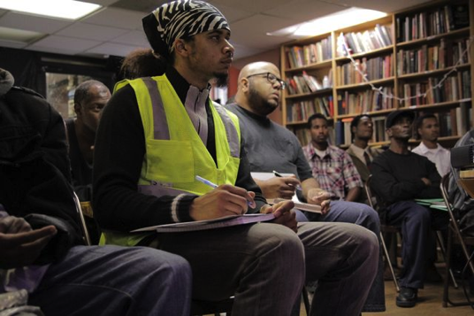
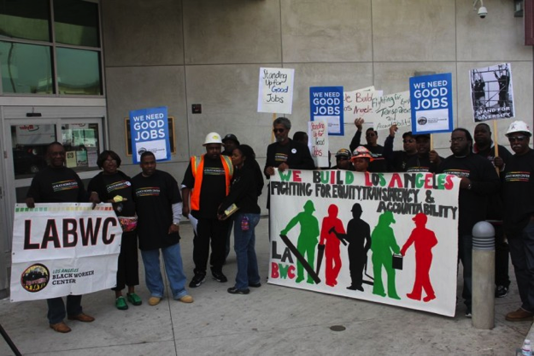
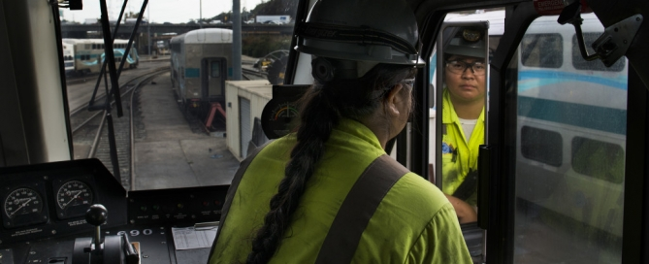
Workforce Development Program
RECOMMENDATIONS
Ensure that individuals facing barriers to employment have access to training and job opportunities created
Monitor local agencies participation in this program and who is able to access jobs locally

Slide 34
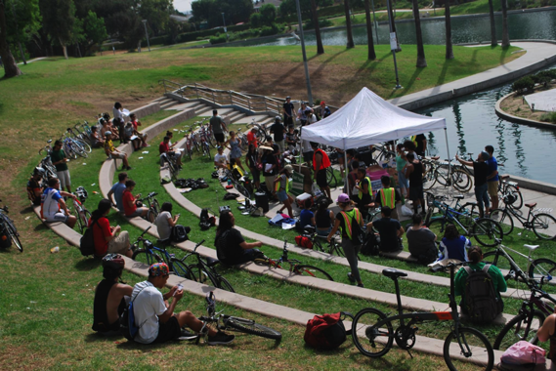
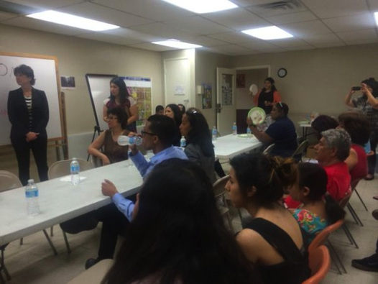
Equity & Community Engagement
Create a priority across all programs for disadvantaged residents and communities
Public participation is critical within program guidelines and project development level
Source: East Yard Communities for Environmental Justice
CTC workshops for guidelines development is fast-moving, important to have meaningful participation from community stakeholders
Leverage funds to transform communities beyond transportation—i.e. housing, land use, clean drinking water investments
Source: Center for Community Action and Environmental Justice

Slide 35
State Guidelines Development Process

Slide 36
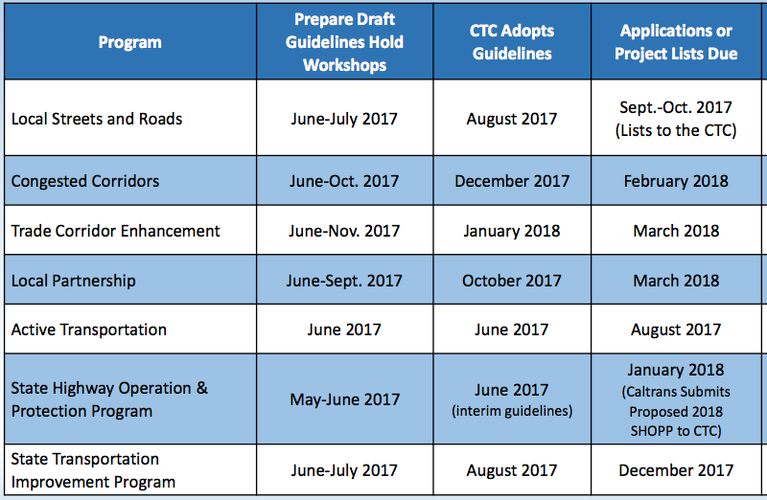
CTC and Caltrans Guidelines Schedule
CTC Guidelines Workshops
July 11, 17, 18 Sacramento
July 21 Los Angeles
Aug 7, 8 Oakland
Sept 8, 25 Sacramento
Oct 19 Modesto
Oct 24 Los Angeles
Nov 17 Stockton
Dec 6 Riverside
Full schedule of CTC workshops and email lists: http://catc.ca.gov/programs/SB1.html
Caltrans Planning Grant website: http://www.dot.ca.gov/hq/tpp/grants.html
Notes:
SB1 continues funding for infrastructure projects along high-volume trade corridors in California.

Slide 37
How to Get Involved

Slide 38
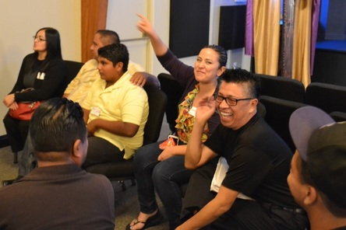
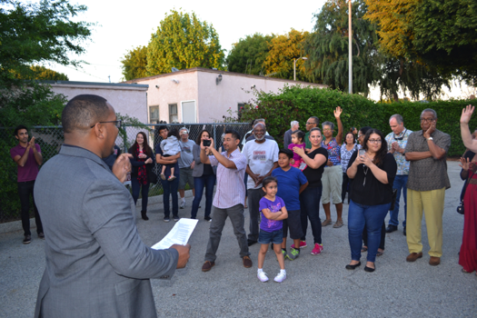
Get Involved
Share recommendations & discuss local needs at local meetings around the state
Contact christopher@climateplanca.org to help coordinate a local meeting in your community
Let us know if you want to be involved in the state guidelines process – email jeanie@calbike.org
Reach out to your local city/county/regional agencies to inquire and influence how funds will be spent locally & what projects to submit for competitive grants
Notes:
SB1 continues funding for infrastructure projects along high-volume trade corridors in California.

Slide 39
Q&A

Slide 40
Using GoToWebinar
Ask questions at any time in the ‘Questions’ box
Technical Difficulties?
linda@calbike.org

Slide 41
Contact Us
Jeanie Ward-Waller
Policy Director
California Bicycle Coalition
Jeanie@calbike.org
Josh Stark
State Policy Director
TransForm
jstark@transformca.org
Carey Knecht
Director
ClimatePlan
carey@climateplanca.org
Erika Rincón Whitcomb
Senior Associate
PolicyLink
ewhitcomb@policylink.org
Jared Sanchez
Policy Associate
California Bicycle Coalition
jared@calbike.org
Michelle Pariset
Policy Advocate
Public Advocates
mpariset@publicadvocates.org
Veronica Garibay
Co-Director
Leadership Counsel for Justice & Accountability
vgaribay@leadershipcounsel.org
Shrayas Jatkar
Policy Advocate
Coalition for Clean Air
shrayas@ccair.org

