Slide 1
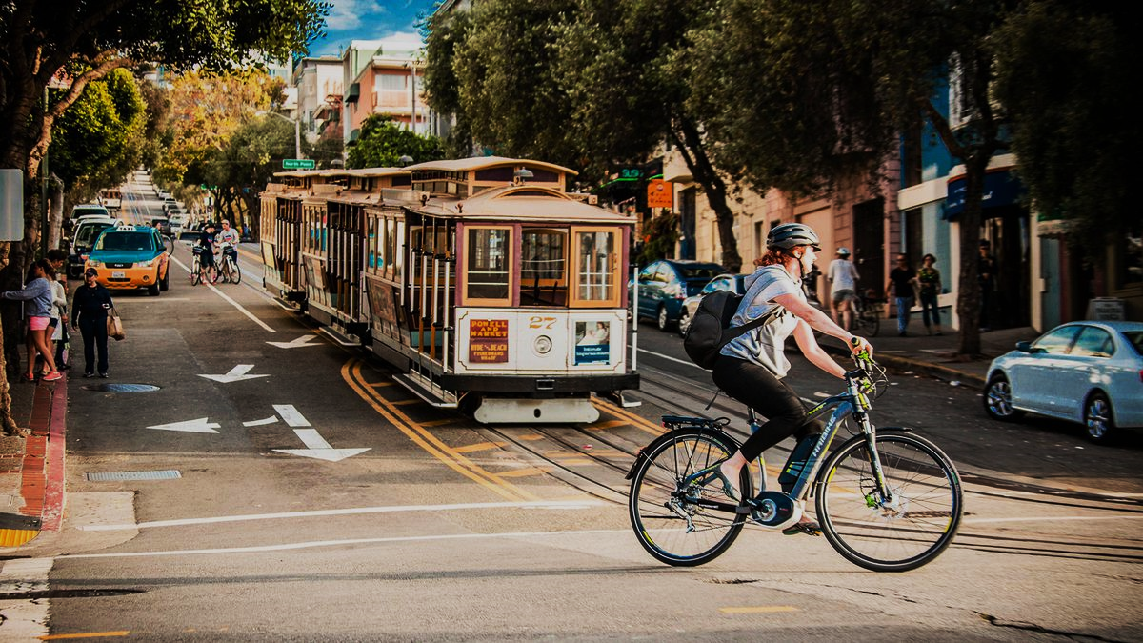
eBikes:
An Innovation in Transportation on the brink of a boom in California
Notes:
Ladies and Gentleman – thanks for the opportunity to talk to you today about a simple but powerful transportation innovation that is on the cusp of a large boom in California and beyond. The eBike. And in the next 5 minutes, I’d like to give you the what, who, when, & why of eBikes to give you a better understanding of why they’re important to mobility.

Slide 2
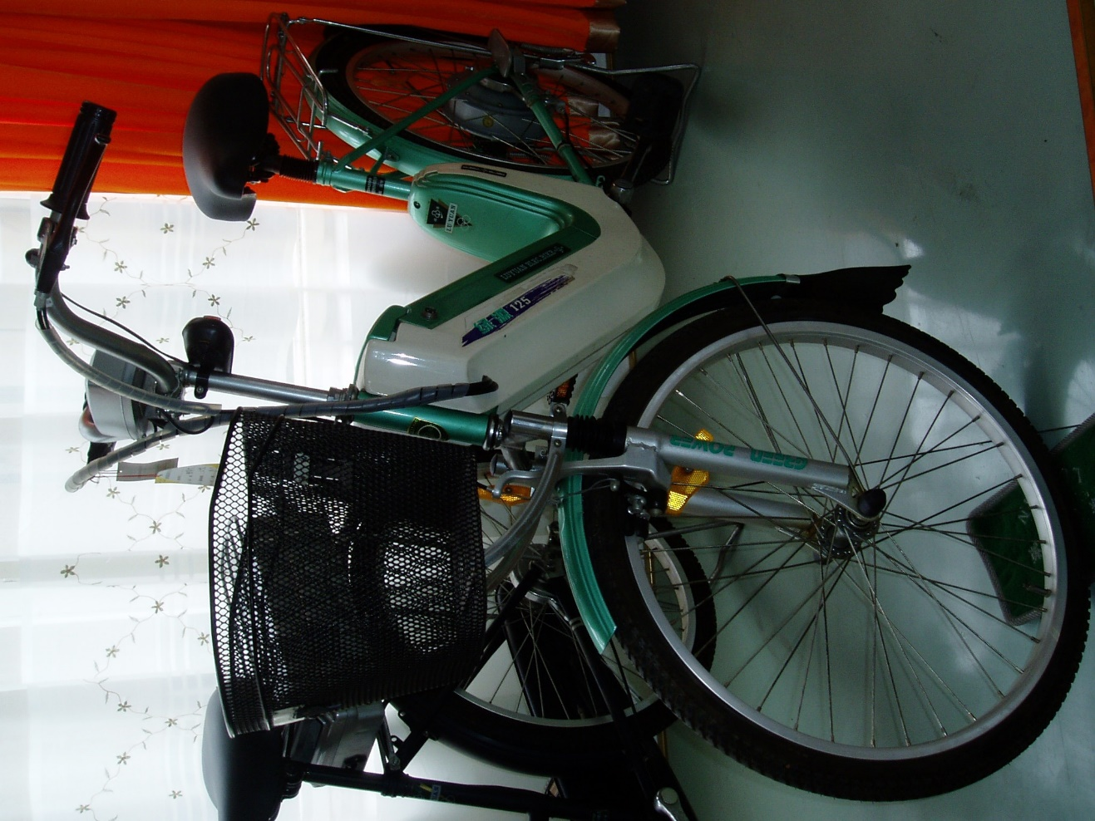
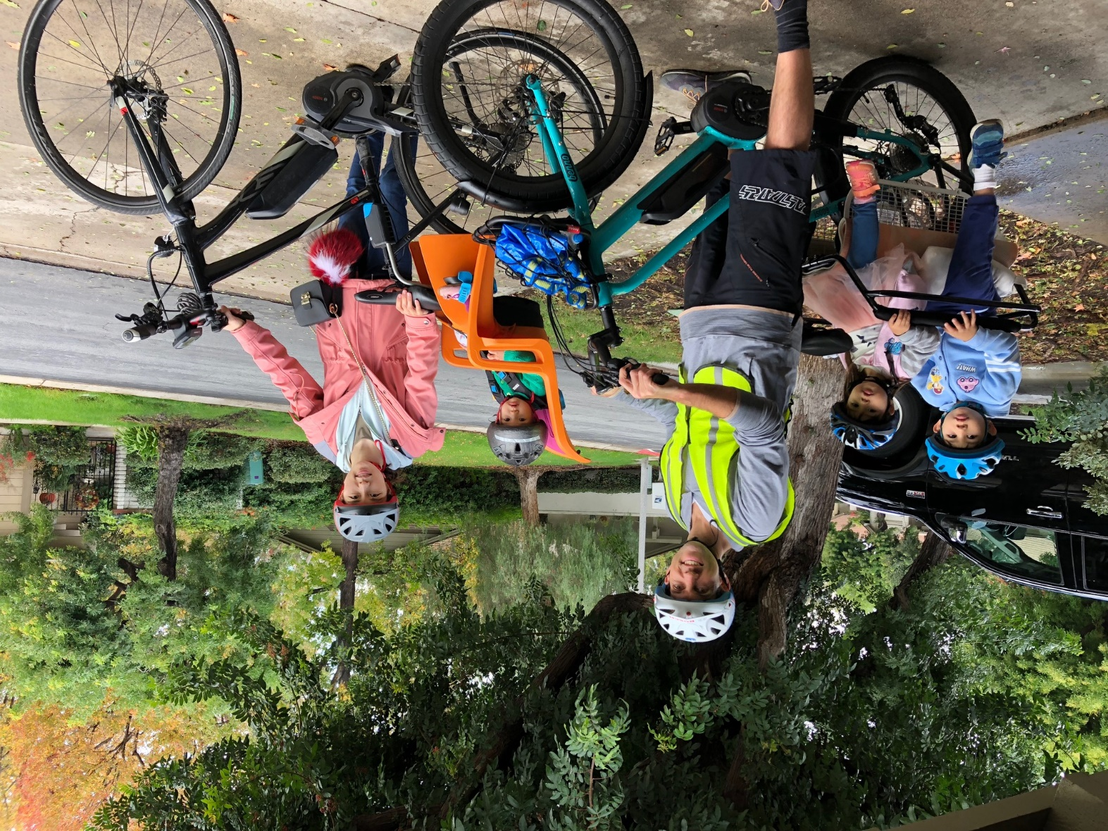
From 2006 to 2018
What’s an eBike?
Notes:
Before I begin, a brief introduction: I come to you today to talk about eBikes wearing 3 hats:
1st, as a supplier in this industry. I work at Bosch eBike Systems in Irvine CA.
2nd, as a researcher. This is one of the first eBikes I saw as I did my doctoral research on electric two wheelers back in 2006 under guidance from Dan Sperling at ITS-Davis.
And 3rd, as an eBike commuter (here you see my eBike carrying some precious cargo).

Slide 3
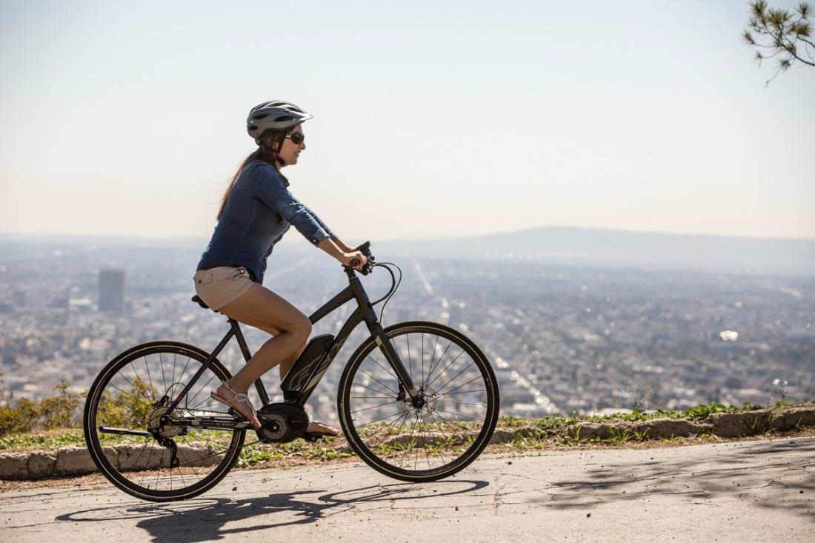
What’s an eBike…today?
<750 Watt Drive Unit: powered by a lithium-ion battery
Charged in 3-4 hrs: uses standard 110V wall outlet for 20-100 miles per charge.
Usually pedal-assist: drive unit engages only when pedaling, allows assisted speeds of up to 20 or 28 mph. (Can be throttle-controlled up to 20 mph.)
Pedal-assist eBikes preserve the healthy human element of cycling with physical and social benefits.
61
Internal | AE-EB/SAM-NA | 2018-11-14
© Robert Bosch GmbH 2018. All rights reserved, also regarding any disposal, exploitation, reproduction, editing, distribution, as well as in the event of applications for industrial property rights.
Notes:
eBikes have come a long way since 2006: the two biggest innovations being batteries, which are way cheaper, lighter, and longer lasting; and pedal-assist control, which makes an eBike feel like a bicycle. Some eBikes also have a throttle. eBikes are typically pedaled, and thus preserve the healthy human element of cycling, and makes cycling more fun by flattening hills.

Slide 4
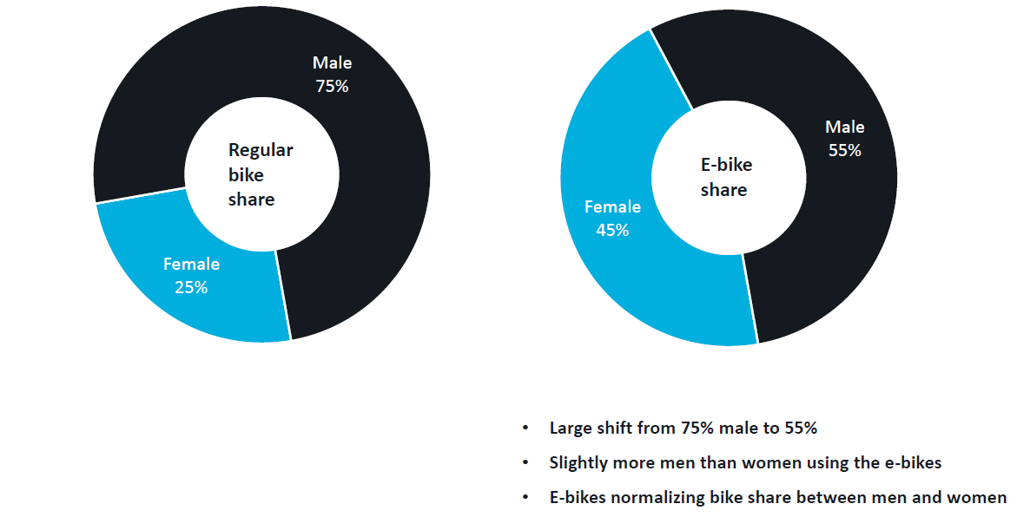

Who eBikes?
Notes:
eBikes are important because they are getting more people on two wheels. One example from a UK Study by Steer. Bike share systems traditionally have been plagued by limited participation from typically young men. In their study, they found that a new eBike share system in the UK attracted significantly more women riders than their previous non-electric system.

Slide 5
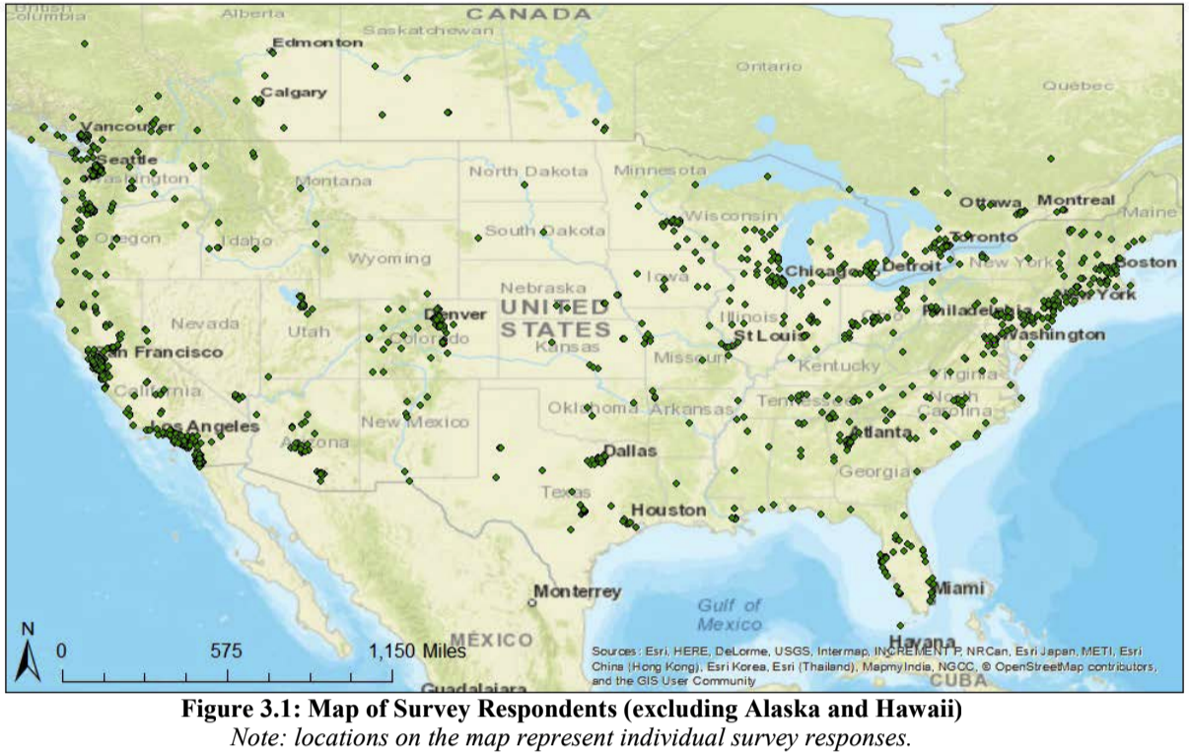
Why do they eBike?
In 2017, researchers John MacArthur (Portland State University) and Chris Cherry (University of Tennessee) conducted a survey of 1,796 respondents that own or regularly operate an eBike within North America.
Notes:
Two researchers John MacArthur from Portland State University and Chris Cherry from University of Tennesseee have been exploring why people eBike. Their recent survey of nearly 2thousand eBike owners reveals some important findings.

Slide 6
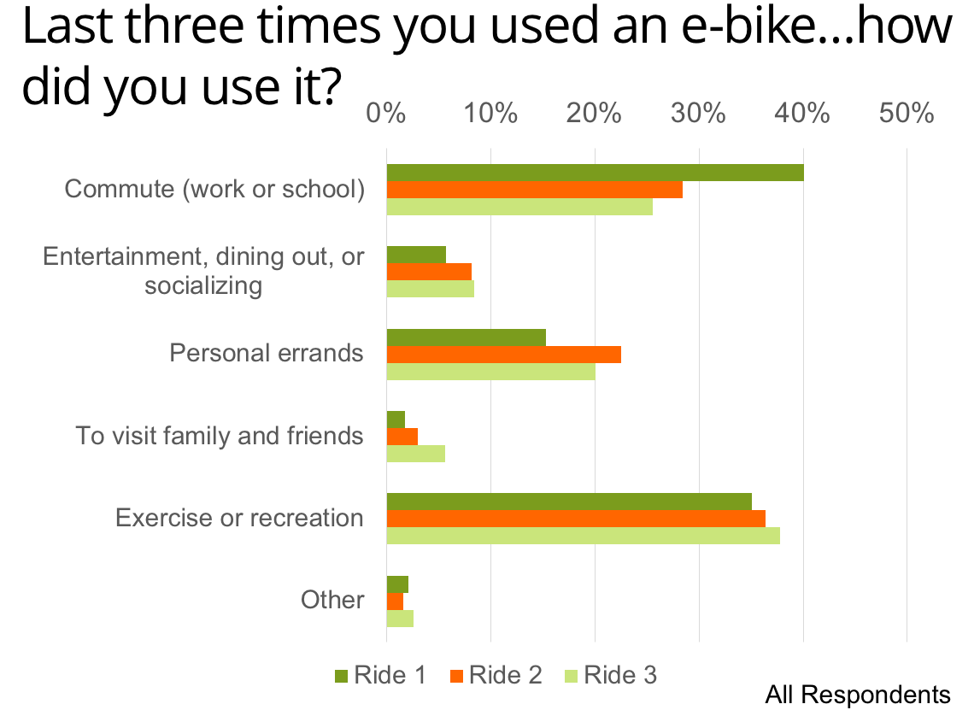
Why do they eBike?
Source: Cherry & MacArthur 2017
eBikes used as both tool (for commuting) and toy (exercise & recreation).
Notes:
First, people use eBikes primarily as for Exercise & recreation, and as a transportation tool to commute.

Slide 7
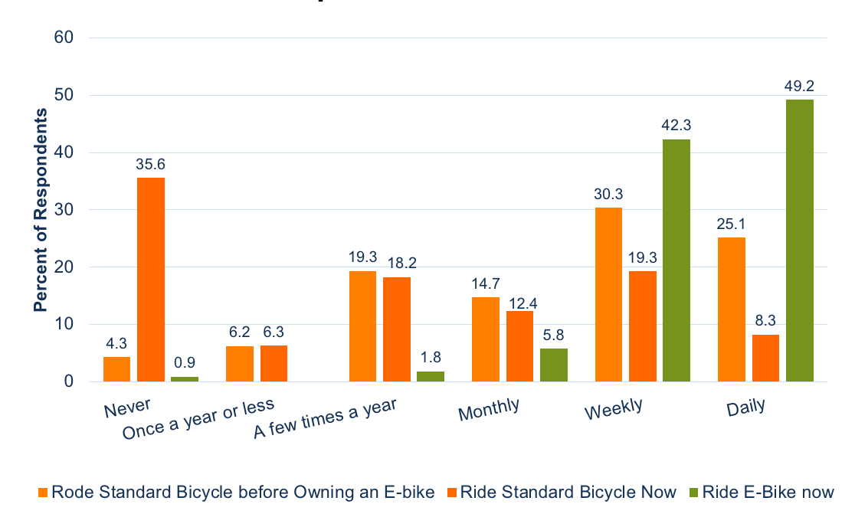
How often do they eBike?
Why do they eBike?
Bike Ridership Rates
Source: Cherry & MacArthur 2017
eBike owners ride more often after converting from bicycle.
Notes:
eBike owners ride more often after converting from bicycle. In separate research that Bosch conducted, we found eBike owners ride 3X times as often and 3X as far.

Slide 8
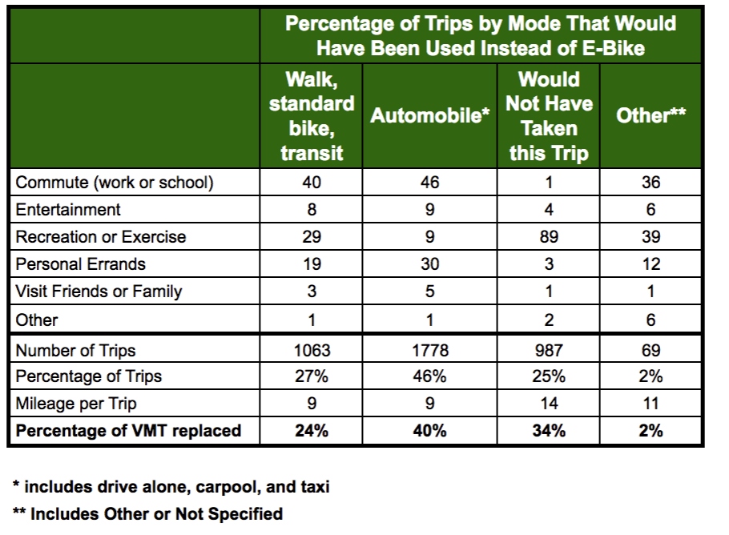
Trips Replaced
by E-Bikes
Source: Cherry & MacArthur 2017
eBike trips replace car trips most often.
Notes:
Most importantly, to the benefit of clogged Californian streets, eBike trips seem to be replacing car trips most often, as you’ll see in the chart.

Slide 9
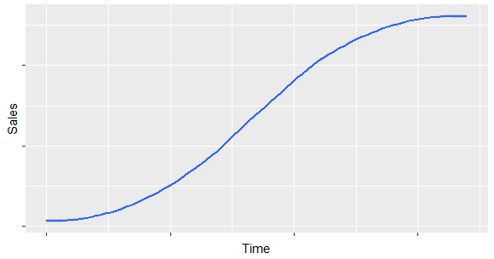



On the brink of a boom…
Where is the U.S. eBike Market?
Initiation
Growth
Saturation
 | eBike Market (sales/yr) | Share of Bicycle Market
EU | ~2 million pcs | 9%
US | 0.2 million pcs | 2%
eBike sales are still far behind Europe, but catching up.

Slide 10
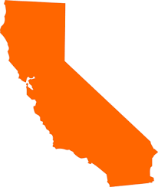
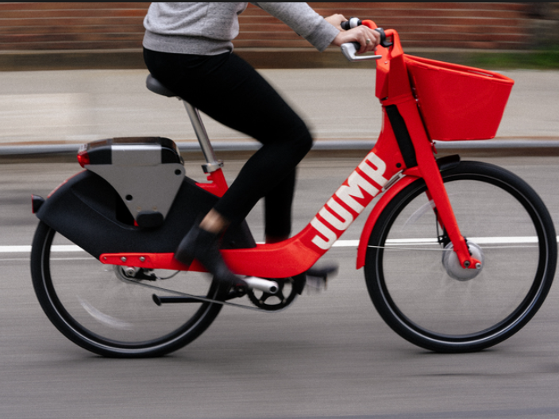
Where is the U.S. eBike Industry Predominantly?
Bosch | Irvine
Specialized | Morgan Hill
Giant | Thousand Oaks
Uber / Jump | San Francisco
Lime | San Mateo
Shimano | Irvine
Yamaha | Cypress
Electra | Encinitas
Accell (Haibike, iZip) | Simi Valley
Pedego | Fountain Valley
Pure Cycles | Burbank
Tempo | Long Beach
Genze | Fremont
XtraCycle | Oakland
Benno Bikes | San Diego
… in California!
California is on the leading edge for both eBike use, and eBike innovation.
Notes:
Not surprisingly, the epi-center of the eBike market is in California. It’s also the epi-center of the eBike industry, these are just some of the companies based in California.

Slide 11




Why are eBikes important to California?
BPM
Increase in physical activity for more people more of the time
GHG
Reduction of GHG emissions by getting more people out of their cars
GDP
Economic impact of growing industry
VMT
Reduced barriers to cycling means more biking, less VMT, less congestion
eBikes: low-cost solution for fighting obesity, climate change, and congestion.

Slide 12



Thank You!
Notes:
I’d like to thank the California Bicycle Coalition, Portland State University, and University of Tennessee for their support, and you for your time and interest in this topic.

